Slide 1
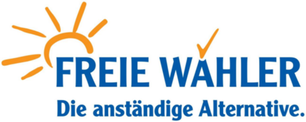
EU at the Crossroads:
How will 2017 national elections change the face of Europe
The Impact of the forthcoming
German federal elections
05 / 05 / 2017 Bratislava Karl Ilgenfritz, M.A.

Slide 2
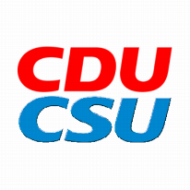
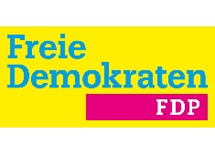
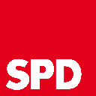
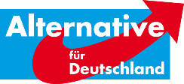
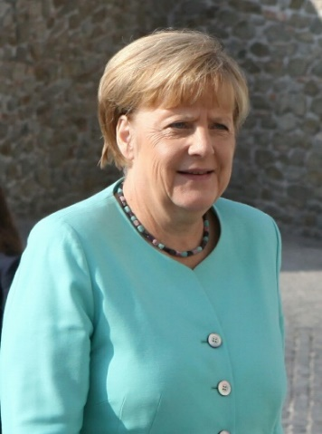
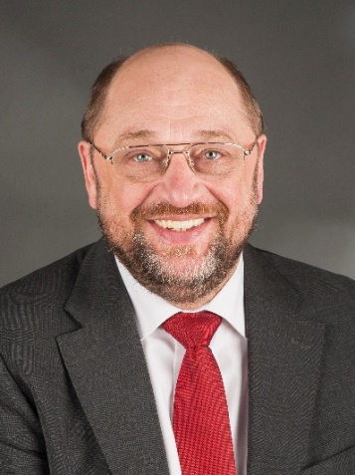
”Stable pro-European majorities will continue
in the Bundestag“
Consensus on Europe in the political center
Political isolation of right-wing populism in the parliaments
➔ No perspectives for government participation
A pro-European will become the next chancellor: Merkel or Schulz
36 % 29 %
05 / 05 / 2017 Bratislava Karl Ilgenfritz, M.A.

Slide 3
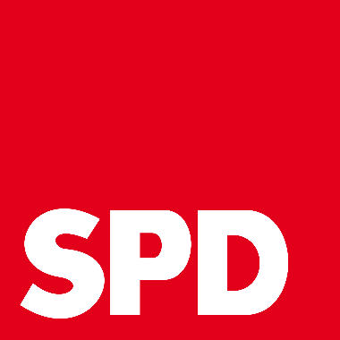
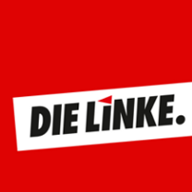
“The danger of a left-wing eurosceptic coalition is imminent“
A red-red-green soft eurosceptic government is possible
For the Left, the EU is…
…“neo-liberal”
…“militaristic”
…“undemocratic”
05 / 05 / 2017 Bratislava Karl Ilgenfritz, M.A.

Slide 4
“The trap of the ‘grand coalition‘“
The Austrian case
The German case
Two pro-European coalitions are possible
„Groko“
„Jamaica Coalition“
05 / 05 / 2017 Bratislava Karl Ilgenfritz, M.A.

Slide 5
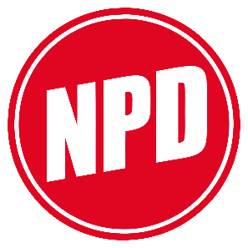
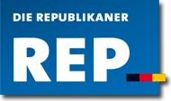
“Germany has good chances to succesfully
contain right-wing populism“
Constantly quarrels inside right-wing populist/extremist organisations
The historical heritage: Germany remarkably resistant to the virus of right-wing populism/extremism
5% threshold
Low turnout rates could strengthen right wing populism
1969: 4.3 percent
1990: 2.1 percent
1998: 1.2 percent
05 / 05 / 2017 Bratislava Karl Ilgenfritz, M.A.

Slide 6
Short digression: The „Alternative für Deutschland“
Huge financial resources
Comprehensive mobilisation via social media
Represented in 11 regional Parliaments (147 of 1855 mandates by now)
Represented in 2 EP groups (ENF and EFD²)
Could be third-strongest party and opposition leader
05 / 05 / 2017 Bratislava Karl Ilgenfritz, M.A.

Slide 7
Development of the AfD up till now
05 / 05 / 2017 Bratislava Karl Ilgenfritz, M.A.

Slide 8
European Comparison of right-wing populist parties
05 / 05 / 2017 Bratislava Karl Ilgenfritz, M.A.

Slide 9
“Right-wing populism could indirectly shape the political landscape: higher resistance to EU integration is conceivable“
Hard eurosceptiscism could be represented in the Bundestag
Soft euroscepticism in the conservative camp will be stuck between a rock and a hard place → The Tories‘ fate
→ Impact on the German agenda on EU integration
05 / 05 / 2017 Bratislava Karl Ilgenfritz, M.A.

Slide 10
“Free Voters play a key role to hamper right-wing populism“
The Free Voters‘ role in the formation of the AfD
Pro-European
Eurosceptic
FREIE WÄHLER
(Party)
Support in 2012/13
Wahlalternative 2013
(Kind of Political Action Committee)
First German party criticising the European monetary policy
AfD
(Party)
05 / 05 / 2017 Bratislava Karl Ilgenfritz, M.A.

Slide 11
The contribution of the Free Voters against right-wing populism
„The reputable Alternative“
05 / 05 / 2017 Bratislava Karl Ilgenfritz, M.A.

Slide 12
Conclusion
A big pro-European majority is out of question
→ Good chances to maintain a pro-European course
2 possible scenarios of a restrained policy on Europe:
A left-wing ‘soft eurosceptic‘ government could block a pro-European reform agenda
The right-wing populists‘ ‘hard euroscepticism‘ could indirectly shape a pro-European reform agenda
→ The Franco-German Tandem could slow down
05 / 05 / 2017 Bratislava Karl Ilgenfritz, M.A.

