Slide 1
I cambiamenti climatici
Antonio Navarra

Slide 2
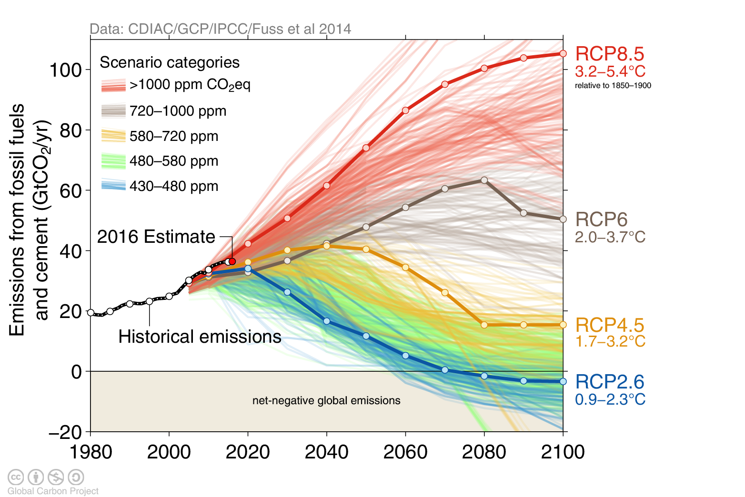
Emissioni osservate e scenari

Slide 3
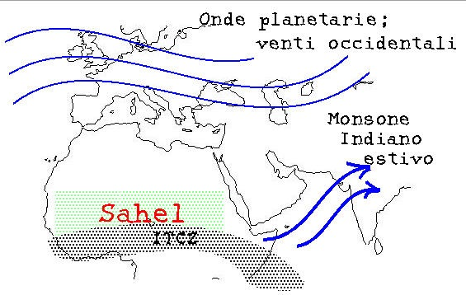
La Regione Mediterranea
Medie LAtitudini
Monsone Indiano
Planetary waves and Westerlies
Summer Indian Monsoon
Sahel
InterTropical Convergence Zone

Slide 4
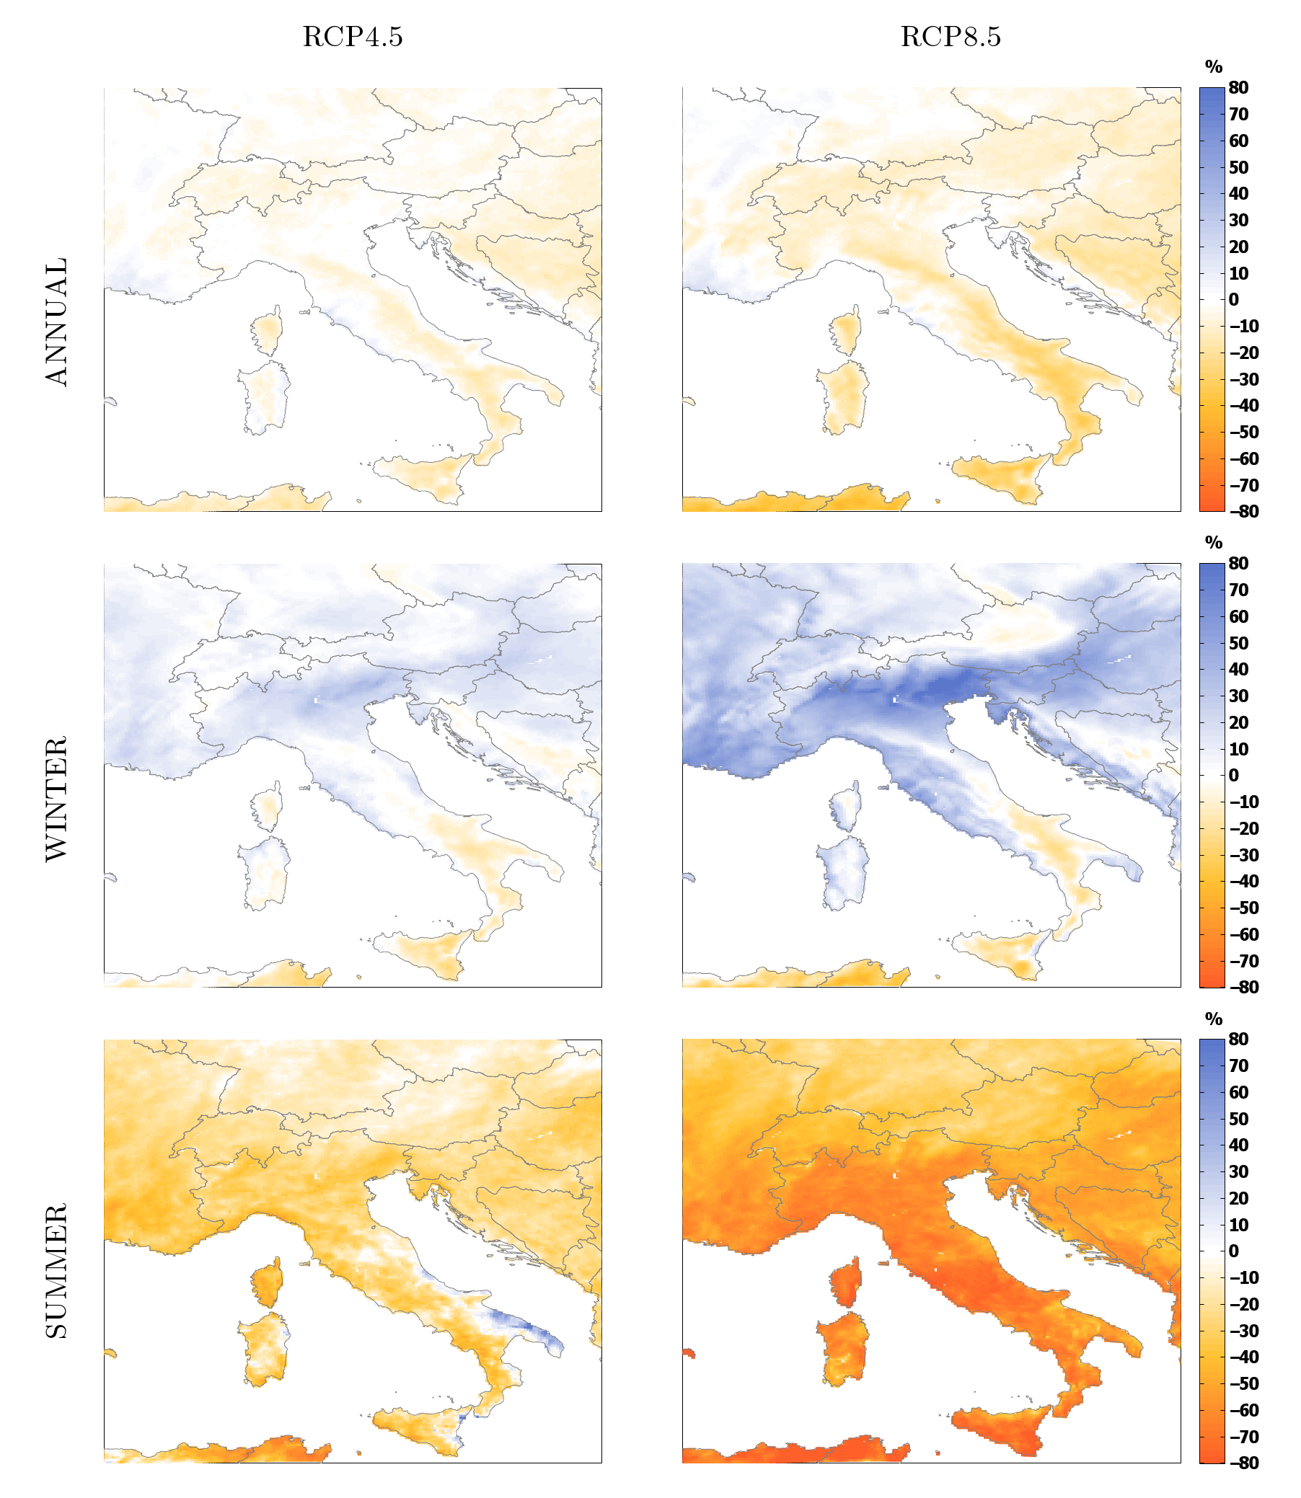
Il ciclo stagionale delle piogge

Slide 5
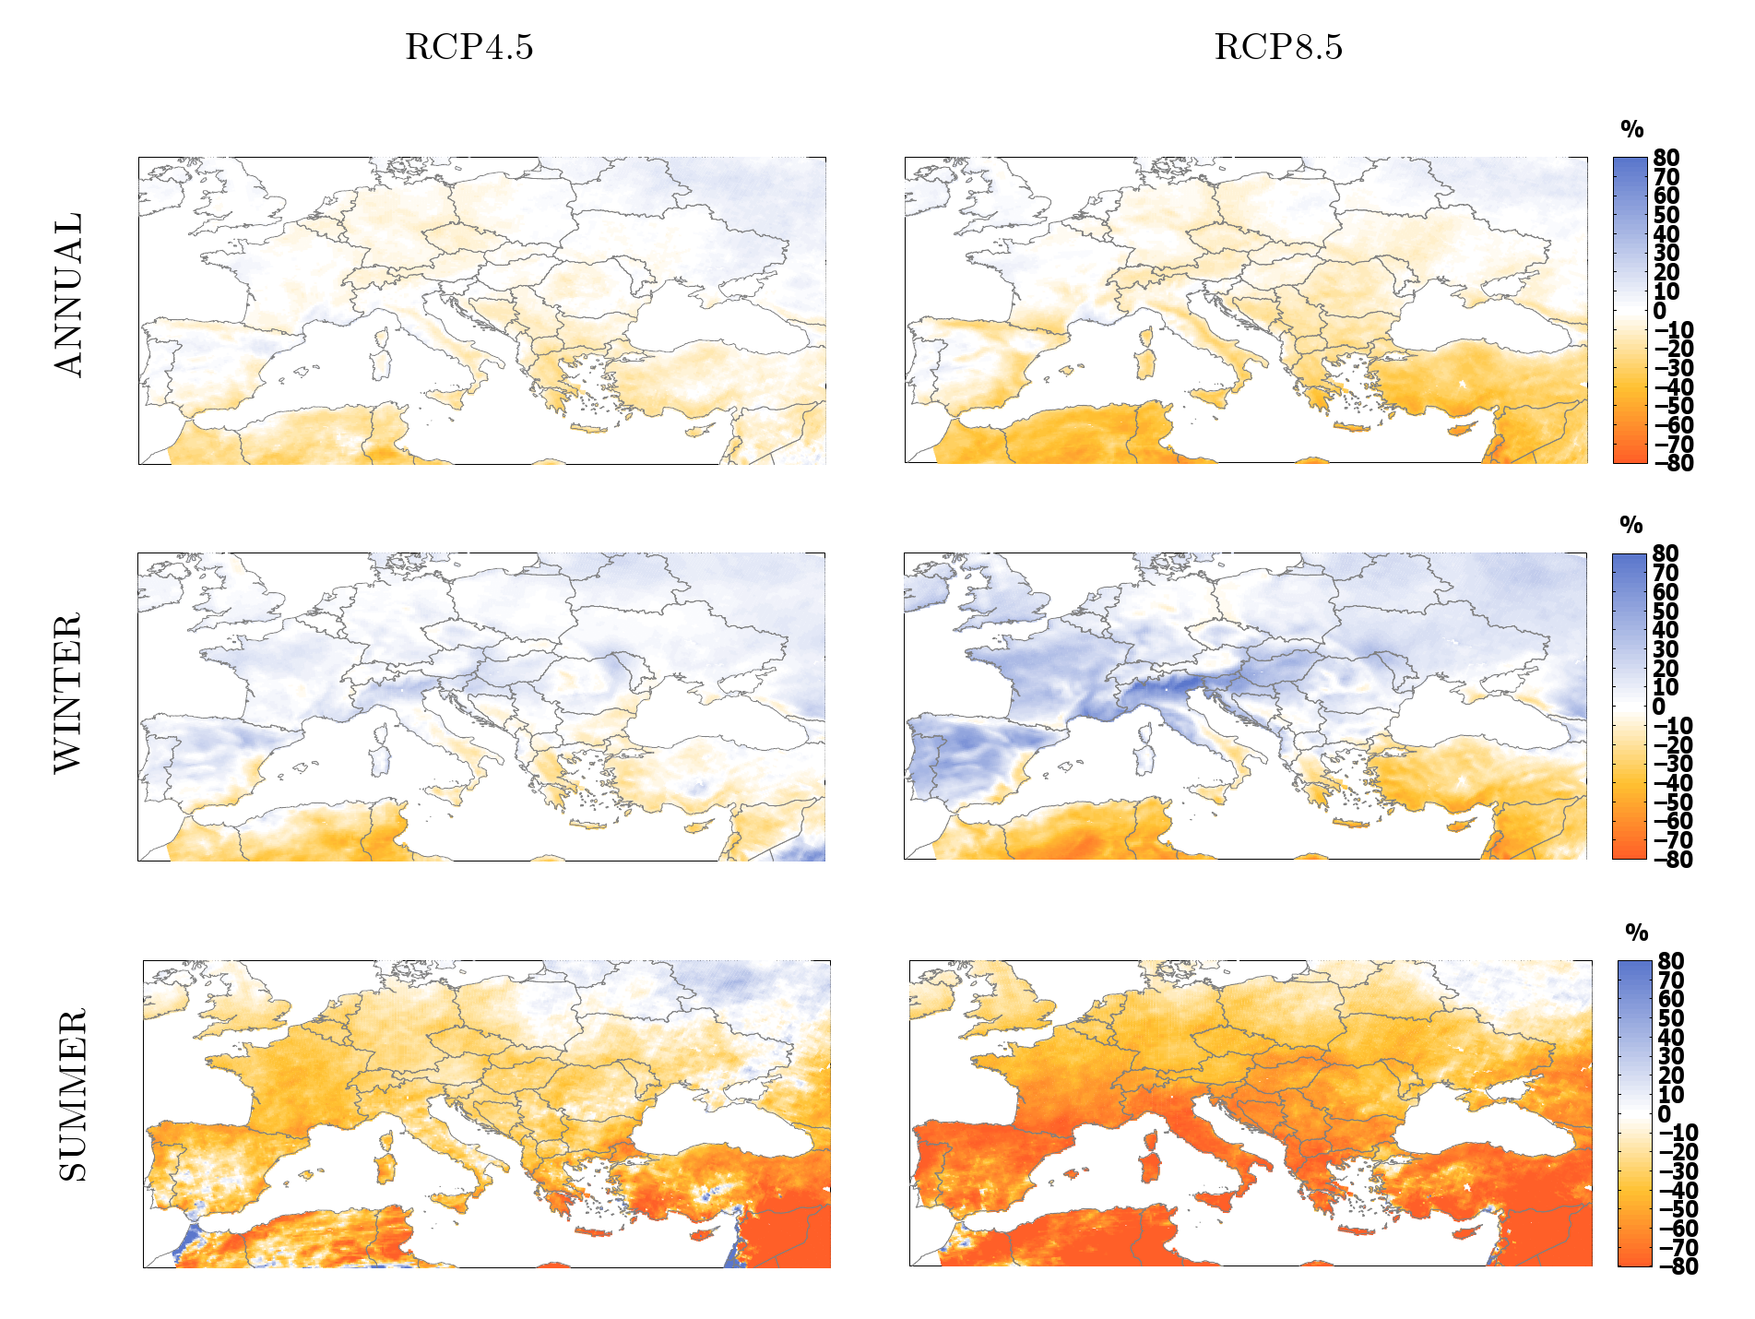
I nostri vicini

Slide 6
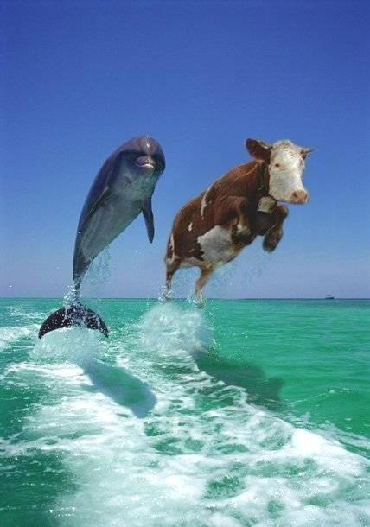
Ci sono dei limiti all’adattamento ?
Mucche olandesi,
2100 circa

Slide 7
Factors
Environmental factors are becoming a key factor in economic, social and political dynamics.
Climate change is an amplifying factor with the potential of strong social and political effects via the impacts on food, energy, economic systems and migratory fluxes.
Environmental and climate data are becoming more and more available from a variety of sources, observations platforms, models and other assets, there is a urgent need for an integrated view.
In the present interconnected world, remote climate and environmental events can have direct national impacts via destabilisation of countries, diffusion of radicalism, increasing poverty and humanitarian emergencies.

Slide 8
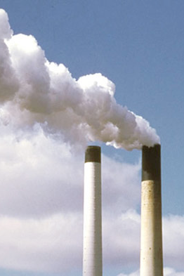
Il tradizionale modello riduzionista e’ insufficiente
I problemi emergenti costringono la scienza a considerare complicati problemi multiparametrici.
Emergono nuove tecnologie con il potenziale di unificare settori diversi
La pressione contro le tradizionali barriere disciplinari aumenta
Le universita’ hanno dipartimenti e la societa’ ha dei problemi

Slide 9
convergence
Convergence is the merging of distinct technologies, processing disciplines, or devices into a unified whole that creates a host of new pathways and opportunities. It involves the coming together of different fields through collaboration among research groups and the integration of approaches that were originally seen as distinct or even contradictory
It is a broad rethinking of how scientific research is done.
MIT White Paper

Slide 10
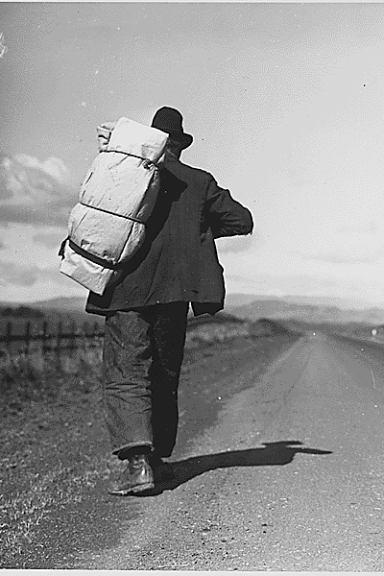
Conseguenze
Aumento dei rischi ? Migrazioni, rischi per la salute, conflitti per le risorse idriche ?
Aumento della solidarieta’ ? Una giusta condivsione delle risorse ? Innovazione e tecnologia, crescita verde ?
Le politiche non saranno formulate a causa dei cambiamenti climatici, masara’ impossibile formulare una politica che non ne tenga conto
Il risultato dipendera’ da noi.

Slide 11
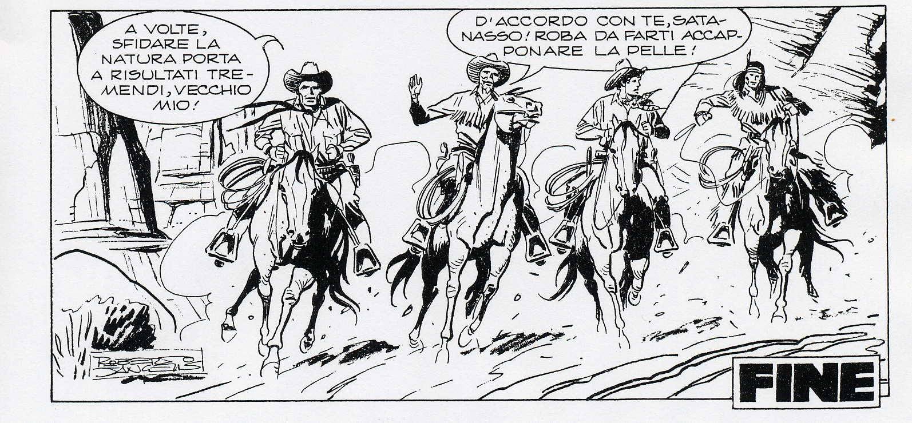
Ottimisti
ma preoccupati

