Slide 1
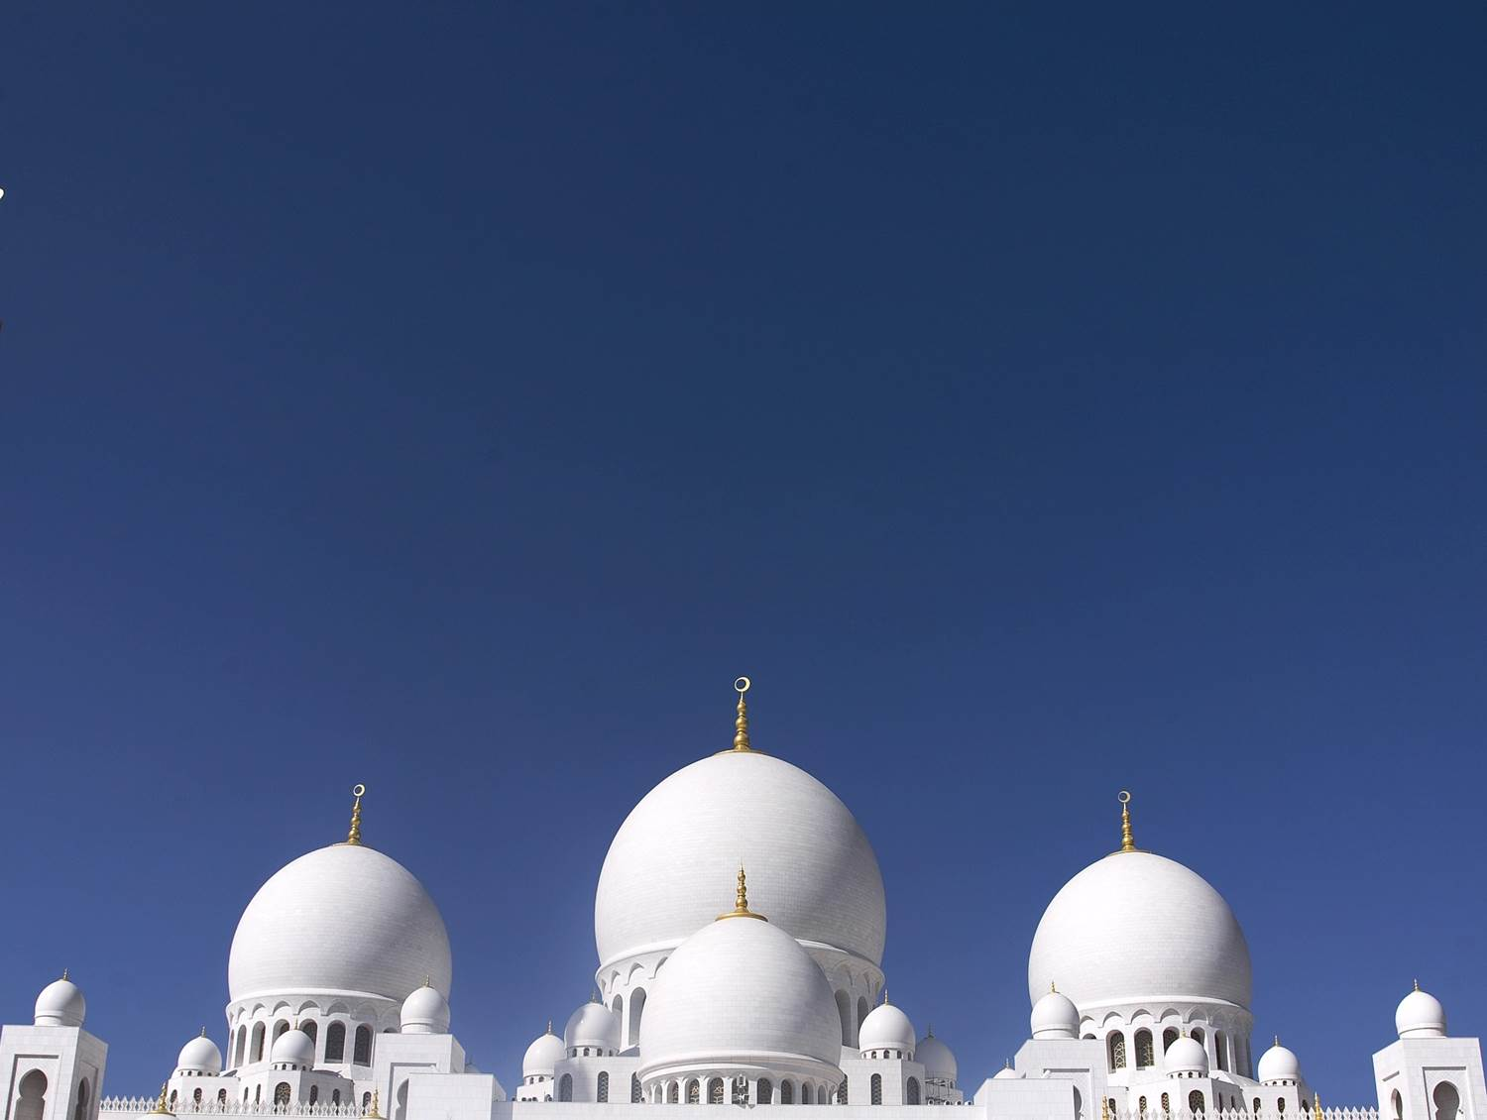
MIDDLE EAST and NORTH AFRICA -MENA- An Economic, Social and Political Outlook 2015
By J F Merladet

Slide 2
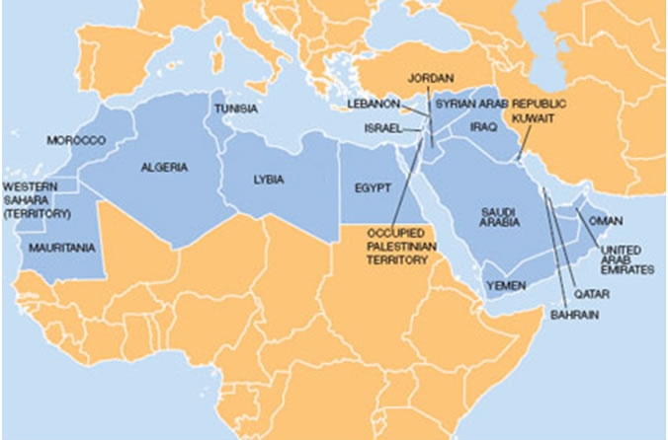
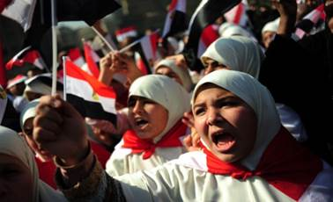
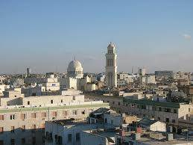
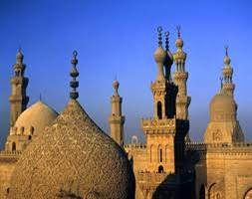
MIDDLE EAST and NORTH AFRICA -MENA- An Economic, Social and Demographic Outlook 2015
by J F Merladet

Slide 3
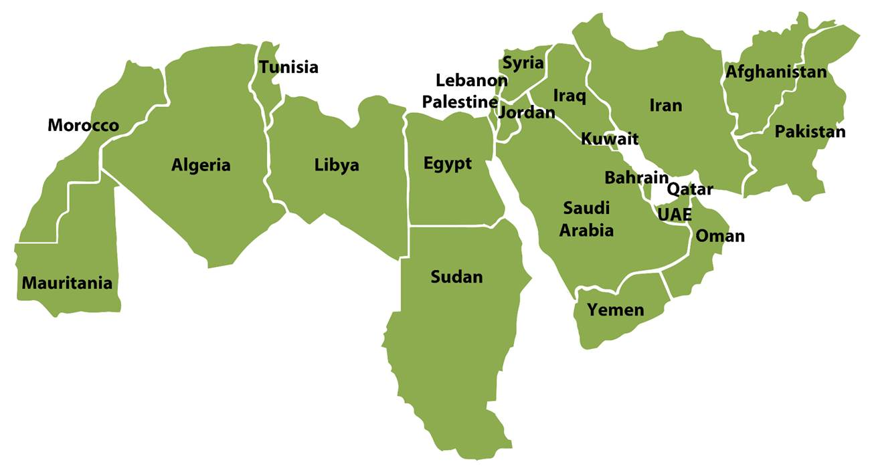

Slide 4
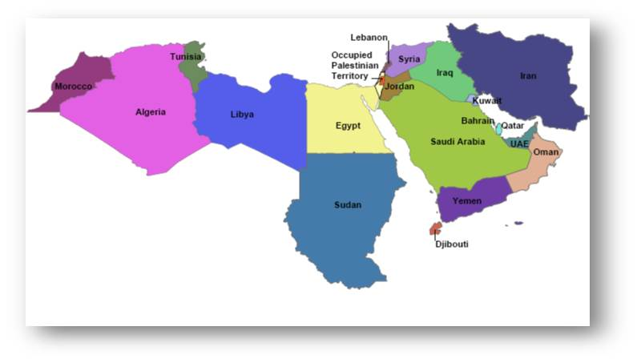
Introduction
The Middle East and North Africa-MENA is a region with rich history, traditions, and geographical, linguistic, ethnic and cultural diversity.
The MENA region had a population of 112 million in 1950. The population is more than 330 million today, about 5-6 percent of the world’s population. Besides employment, population growth presents major problems for education, food security, water supplies and infrastructures such as urban services.
Geopolitically and geo-economically, the Middle East is a region of immense world importance as it produces about one-third of the world’s oil supplies and has 60 percent of the world known petroleum reserves.
To explain the causes of the current crisis, we will concentrate on economic and social issues here, however instead than in religious, security or political ones.
Source: World Bank

Slide 5
General global economic outlook in 2015
In the Middle East and North Africa, growth is expected to remain flat at 2.2 percent in 2015, according to the June 2015 issue of Global Economics Prospects.
The plunge in oil prices is a particular challenge for oil-exporting countries, most of which also have severe security challenges (Iraq, Libya, and Yemen), or limited economic cushioning (Iran, Iraq). (In fact for many these are failed states).
For oil-importing countries, the potential positive effects of lower oil prices are partially offset by spillover effects from more fragile countries in the region, including through lower remittances and security risks. Long-standing structural constraints present a chronic obstacle to faster growth in the region.
There is an expected regional growth rebound to 3.7 percent in 2016-17, predicated on improving external demand, strengthening confidence that boosts investments in some oil-importing countries (Egypt, Jordan).

Slide 6
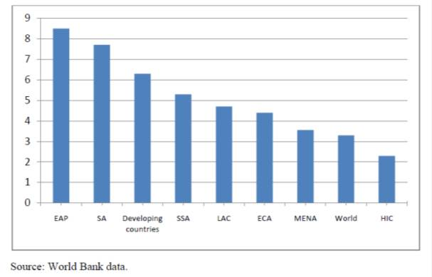
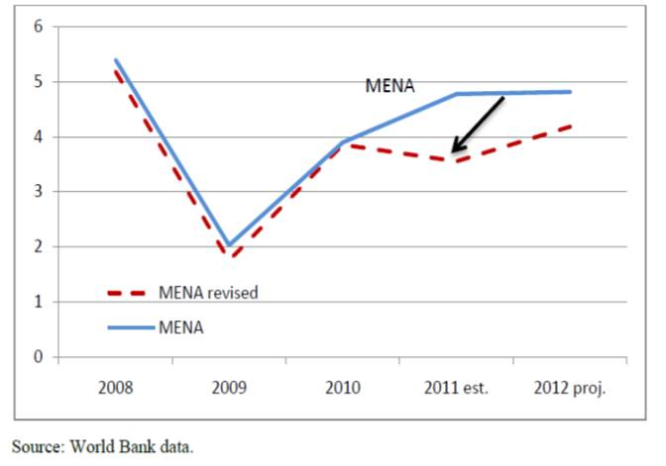
The Global Economy: Figures and projections
Annual Growth Outlook in 2011 (percent)
By the end of 2010, countries in the Middle East and North Africa (MENA) had largely recovered from the global financial crisis, and growth was expected to reach its pre-crisis levels in 2011.
Growth in MENA Marked Down (percent)
However, in early 2011, a series of pro-democracy movements began that resulted in swift regime change in Tunisia, Egypt and Libya, and spread to Bahrain, Syria and Yemen. This has impacted short-term growth, fiscal and trade prospects, inflation, and the status and speed of economic reforms in the region.
Some authors say that every 5 years there is a major crisis in the region: Intifadas, Iraq wars, Arab Springs and now ISIS…

Slide 7
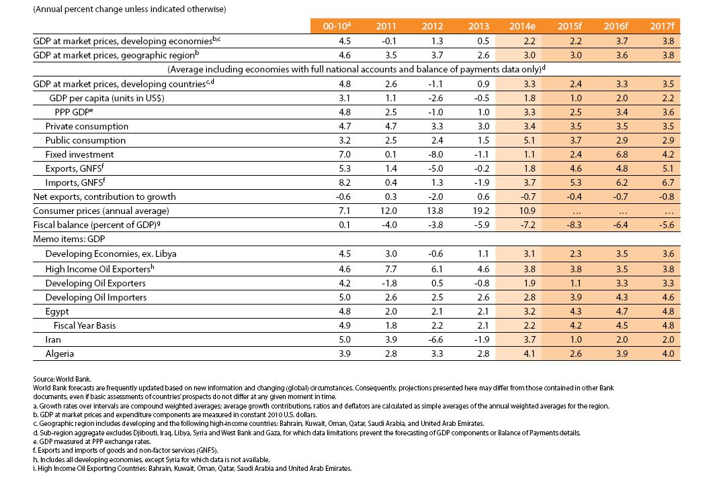
Middle East and North Africa general forecast summary
in 2015

Slide 8
Recent Developments
Regional growth rebounded to 2.2 percent in 2014 (from 0.5 percent in 2013), due to some easing insecurity risks (the Arab Republic of Egypt and Lebanon), strong, credit-fueled domestic demand growth (Algeria), public investment and sanctions relief under two interim nuclear agreements (the Islamic Republic of Iran), and a rebound in oil production in some oil-exporting countries (Libya, Iraq, and the Islamic Republic of Iran). In the first half of 2015, security challenges intensified in oil-producing developing countries. Rebel forces toppled the government in the Republic of Yemen, prompting aerial intervention by Saudi Arabia. Various rebel groups, most notoriously the militant group the Islamic State of Iraq and the Levant (ISIL), advanced into new territory in the Syrian Arab Republic. Conflicting factions in Libya have targeted oil installations to seize or destroy revenue streams. Associates of ISIL joined fighting in Yemen and Libya. ISIL fighters are reportedly massing at the Syrian border with Lebanon and clashing with Lebanese security personnel. In Tunisia, terrorist attack shaves targeted tourists. Growth in the region’s oil-exporting developing countries averaged 1.9 percent in 2014, a recovery from the 0.8 percent contraction in 2013. Oil production stabilized at around 8.2 million barrels per day (mbd), towards the end of 2014 —25 percent below the pre-Arab Spring average— but has since fallen again. Libya was hit hard in the latest quarter as its oil infrastructure came under attack; production fell from 0.7 mbd in 2014 Q4 to 0.3 mbd in 2015 Q1. The Islamic Republic of Iran remains under sanctions, with a cap on oil exports of 1.1 mbd. This limit may be eased if the international negotiations on Iran’s nuclear program are successful. The Islamic Republic of Iran would then contribute an additional 0.7–1.0 mbd to an already over supplied market, keeping prices low, potentially, for a considerable period. Iraq, Libya, and the Republic of Yemen rely heavily on the oil sector for government revenues. As a result of security challenges and falling oil prices, they suffered large revenue declines and widening fiscal deficits. This led to sharp cuts spending and difficulties maintaining basic state functions.

Slide 9
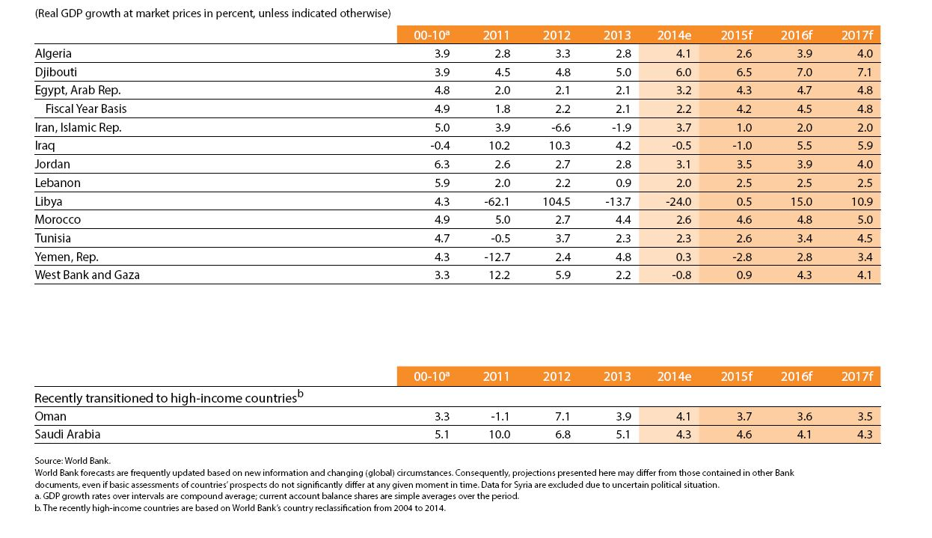
Middle East and North Africa’s countries economy forecasts in 2015

Slide 10
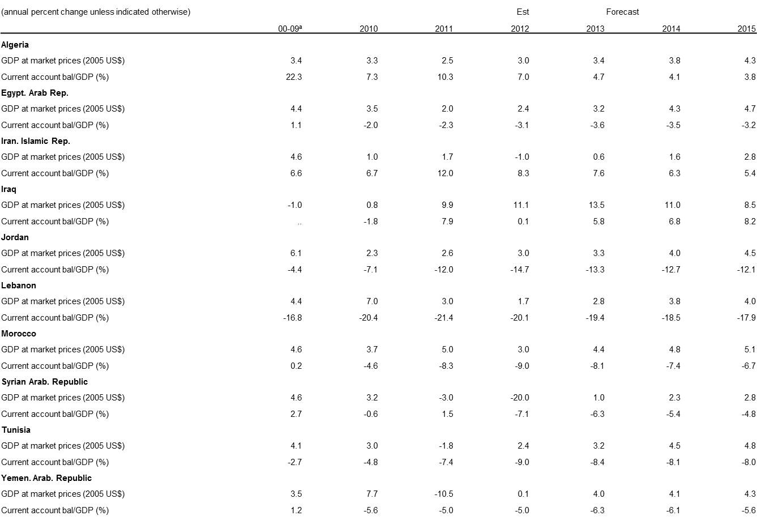
Middle East and North Africa forecast
summary by country in 2012

Slide 11
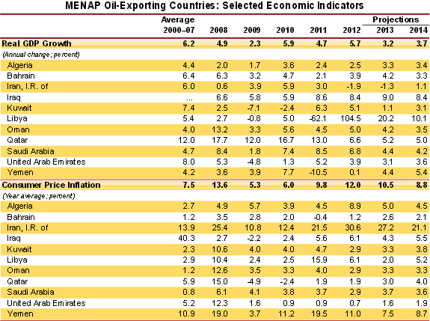
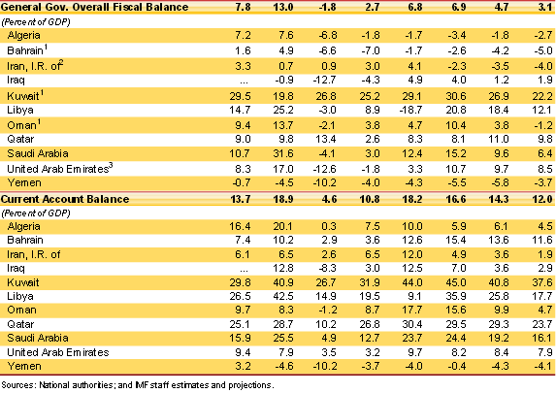
Global Economic Prospects: MENA
Middle East and North Africa forecast summary. Oil exporting countries

Slide 12
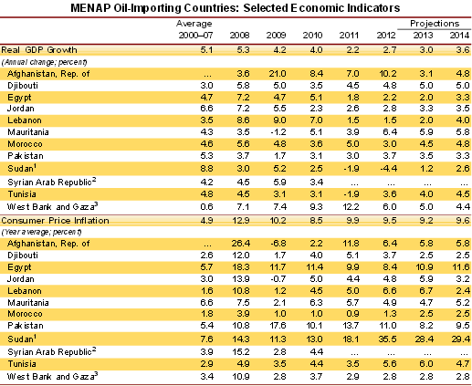
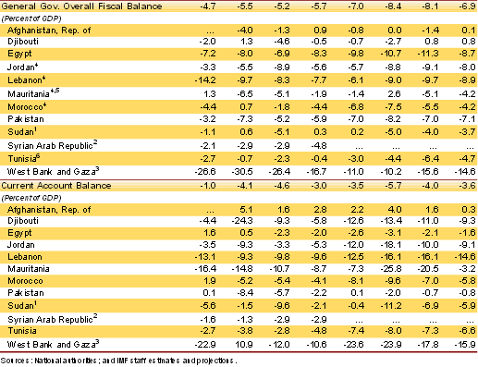
Global Economic Prospects: MENA
Middle East and North Africa forecast summary. Oil importing countries

Slide 13
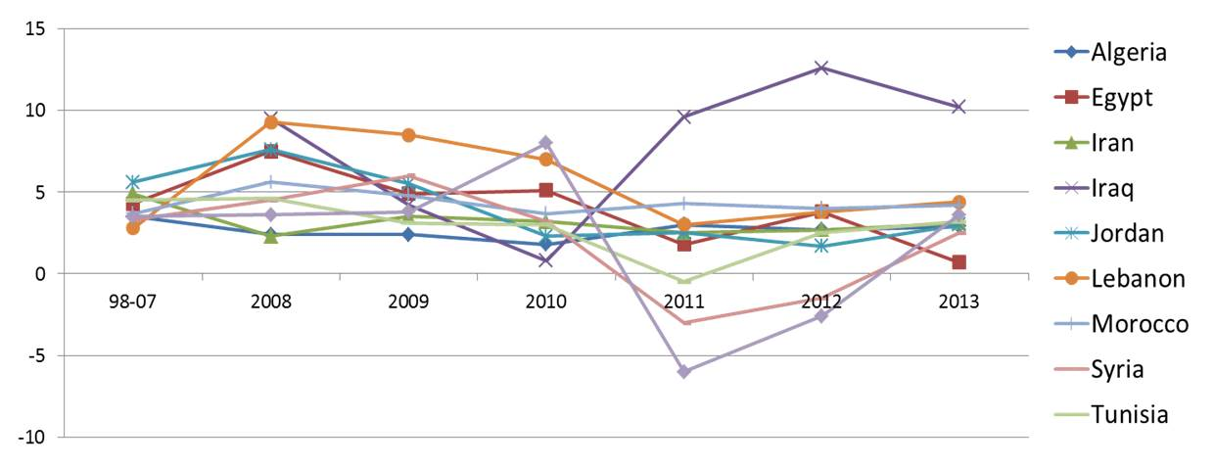
MENA: Regional Distribution of Growth 1998-2013
Source: Global Economic Prospects 2012, World Bank
There is not a constant trend of growth in this region (too much fluctuation).
In the period 2008-2009, there was a massive fall in real GDP growth due to the economic crisis of 2008 (it fell to 0.6%). However, it didn’t take long before it started to recover: real GDP growth increased by 4.5% since 2009.
This growth trend was expected to continue but after the 2011 fell again due to the Arab Springs And now due to civil wars and strife and ISIL Future will depend on the political situation.

Slide 14
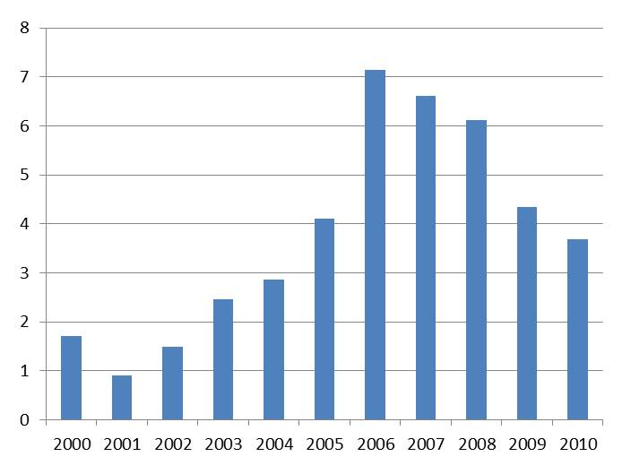
Foreign Direct Investment to the MENA region
The MENA region experienced its maximum FDI flows in 2006—a record $24.9 billion— and outlasted the record achieved in 2006.
Since 2007, FDI flows have been decreasing. Notice the fall of flows in 2009: this is a product of the 2008 world crisis.
This decreasing trend has continued. FDI inflows are likely to decline and because of lack of clarity about the future political developments in the region, the extent to which investment will decline is difficult to quantify.
Intraregional FDI flows increased not only in the energy sector, but also in sectors such as infrastructure, real estate, and tourism.
Foreign direct investment, net inflows (% of GDP)

Slide 15
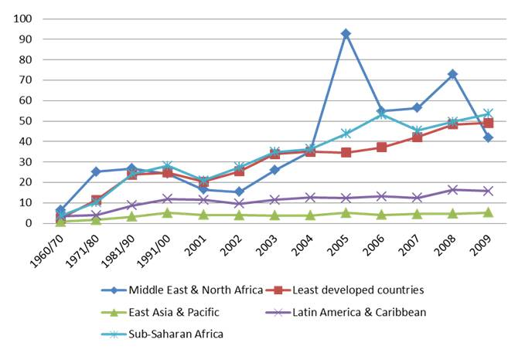
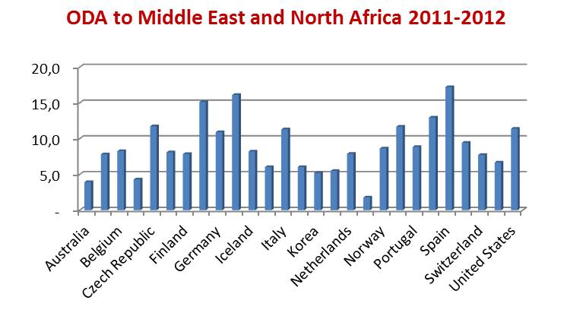
Official Development Assistance to the MENA region
ODA is officially defined by the OECD as government aid to developing countries designed to promote the economic development and social welfare. Aid includes grants, "soft” loans, and the provision of technical assistance. The OECD maintains a list of developing countries and territories, and only aid to these countries counts as ODA.
Over the past five decades there have been significant advances in the MENA region in reducing poverty and advancing human development. Several of the region’s wealthier oil-rich nations are high income countries now and others are no longer defined as developing countries, and the remainder are all classified as Middle Income Countries, with the notable exception of Yemen, the only Low Income Country in the region.
The MENA region receives though significant amounts of official development assistance Egypt received almost 5.5 billion dollars in 1990. In 2008, the amount went significantly down to 1.5 billion dollars (value shared with other African countries) but it is still very high when compared to a country in South America like Peru, for example.
Net ODA received per capita (current US$)

Slide 16
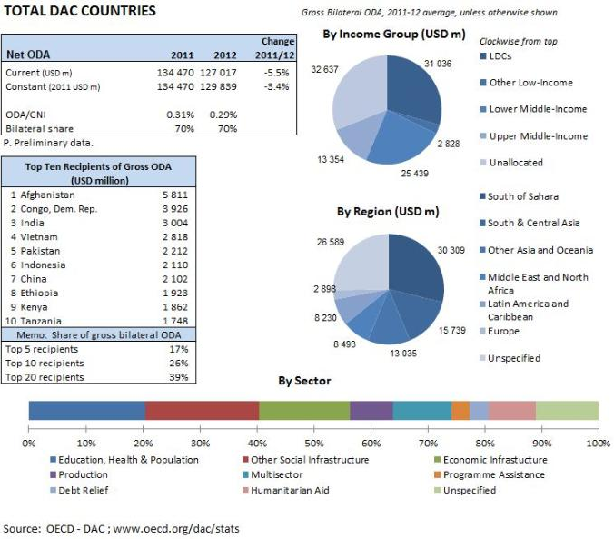
Major recipients of total gross bilateral ODA from DAC countries 2008-2009
Aid allocations and choices of instrument are still substantially influenced by domestic political considerations, including commercial advantage and concerns about foreign policy objectives such as migration and terrorism. This is specially relevant in MENA when considering the constant internal and intra-regional political conflicts and the insecurity environment in the region
Lack of financial resources is often not the problem in the MENA region, for example public spending on education is higher than in any other developing region, but quality remains notoriously low. Effective aid coordination is a challenge in these circumstances, for donors and recipient governments.
The MENA region received 8.493 million dollars of ODA, ranked 4th after Asia & Oceania, South & Central Asia and the Sub-Saharan Africa.
Iraq was the major recipient of aid in the MENA region for 2003-2005 because of the war. This trend continued in 2009 since it still was the first ranked recipient country. Now Iraq is not even on the top 10 recipients of ODA. Afghanistan took its place and ranks first, with a big difference with the second one.
Yemen, while being classified as the only Low Income Country of the MENA region, does not figure amongst the top 10 major recipient countries of the MENA region.

Slide 17
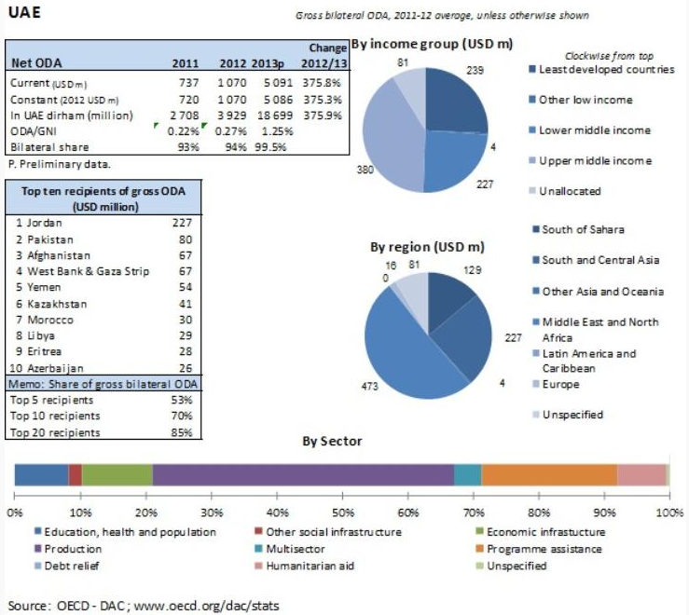
MENA donor Example: United Arab Emirates

Slide 18
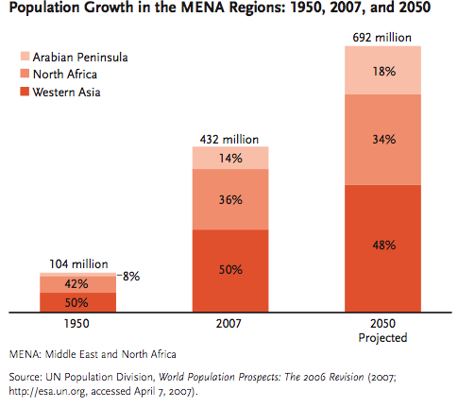
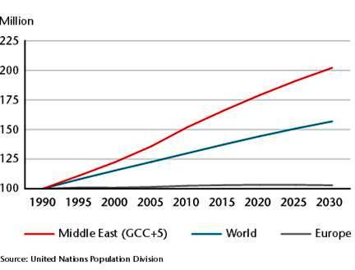
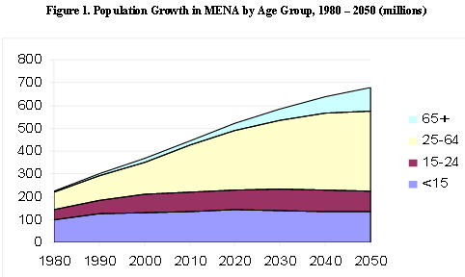
Population Growth and the Employment Challenge
Population Growth in the MENA Regions: 1950, 2007, and 2050
Population in the region has quadruplicated during the last 50 years, but this trend is expected to slow down. Population growth will not even double itself by 2050.
Nevertheless, its population growth rate will still be higher than the rest of the world
Population growth projections: the Middle East compared with the world and Europe, 1990-2030. Index 1990 = level 100
Source: UN Population Division

Slide 19
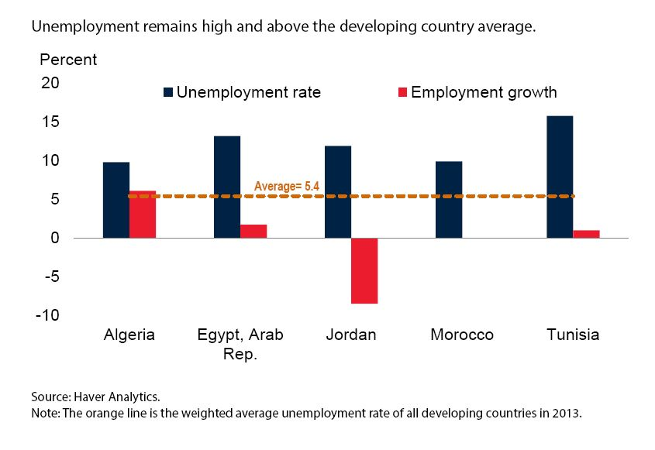
Unemployment rate and employment growth 2013

Slide 20
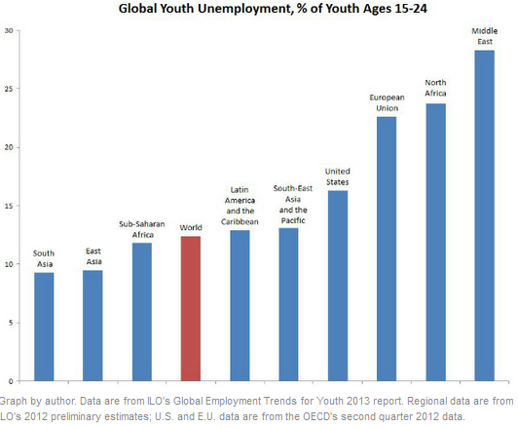
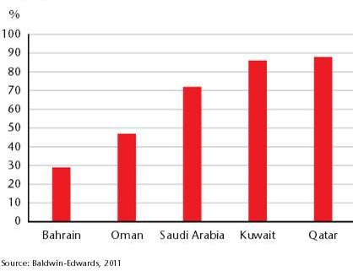
Population Growth and the Employment Challenge
In order to face the employment challenge, the MENA region needs to adopt reforms aimed at:
Opening the region to foreign trade.
Reducing dependency on oil through diversification.
Improving governance (which is another main
cause of the region crisis).
Reducing the dominant role of the public sector n employment creation.
Unemployment is bigger for people aged 15 to 29. This is one of the main causes of the crisis the region is facing nowadays.
Public sector employment as a % of total employment of nationals, 2008

Slide 21
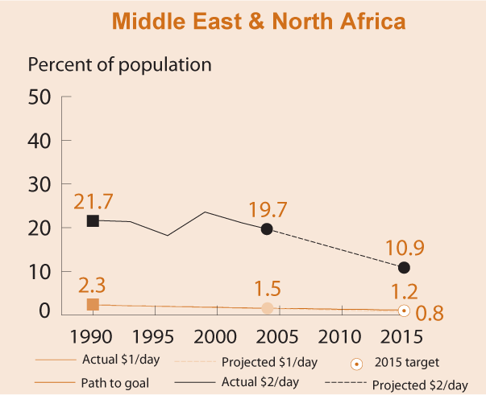
MENA: Facing Poverty
Percent of population living with less than $1 per day
1.3% of the total MENA population in 2010 is poor (less than 1$ a day). The target for 2015 is to reach 0.8%
While low comparing to other middle-income countries, poverty rates in MENA appear to have risen since the end of the 1990s.
Using a poverty line of $2 per capita per day, around 11 % of the population is poor in 2015.
Source: World Bank

Slide 22
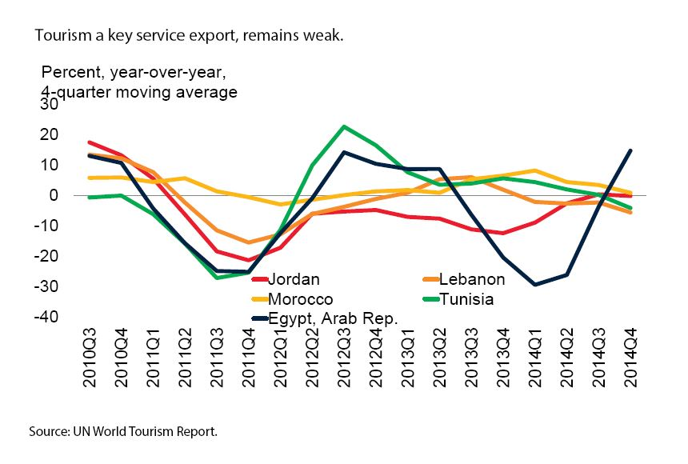
Key sectors: Growth in tourism arrivals

Slide 23
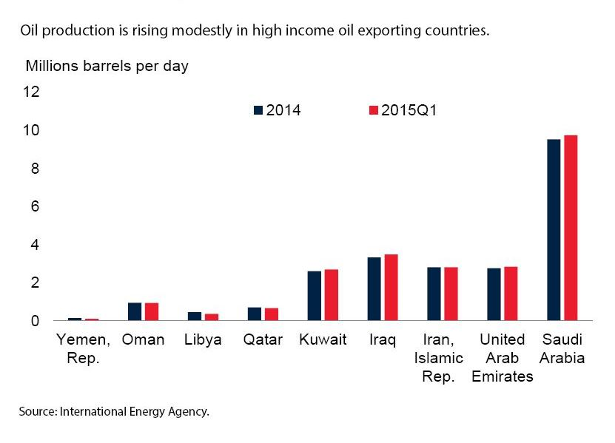
Oil Production

Slide 24
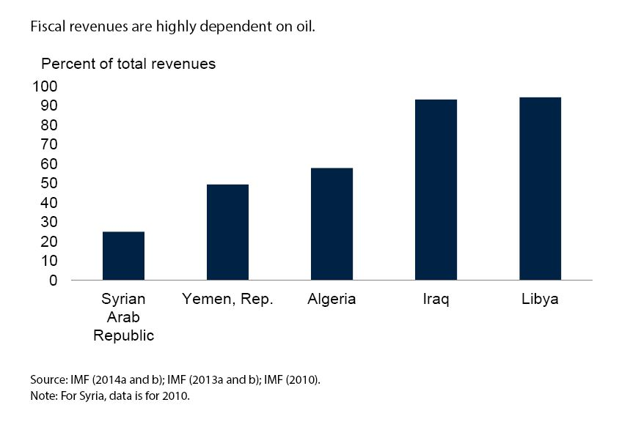
Oil Revenues 2014

Slide 25
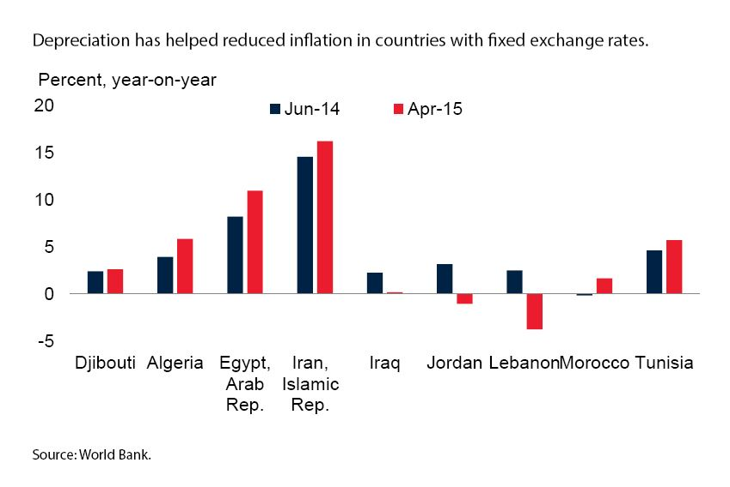
Inflation

Slide 26
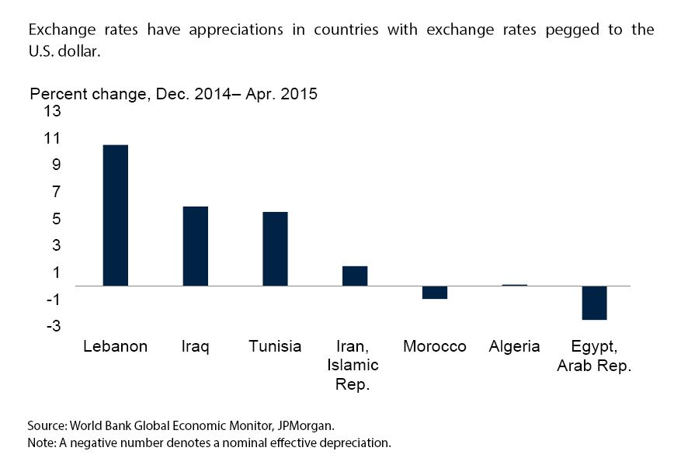
Nominal effective exchange rates

Slide 27
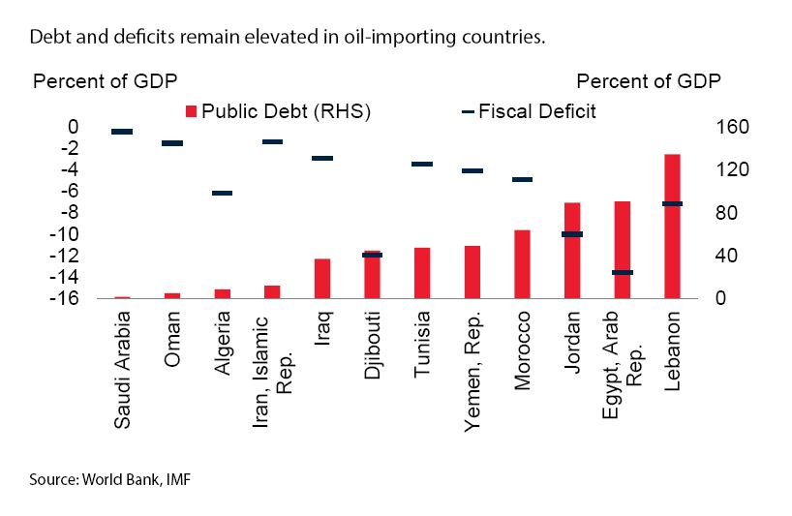
Public debt and deficits 2014

Slide 28
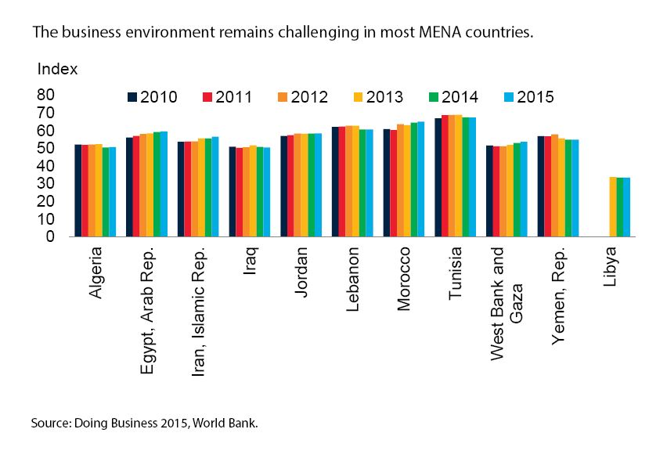
Business climate

Slide 29
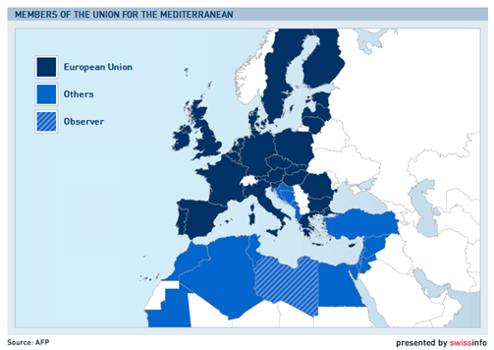
The European Union relations with the MENA region
The MENA region is of vital strategic importance to the EU, and is a key external relations priority. EU policy towards the Mediterranean area is governed by the Union for the Mediterranean (UfM), re-launched in 2008 after the Barcelona Process.
The re-launch was an opportunity to render relations both more concrete and more visible with the initiation of new regional and sub-regional projects with real relevance for those living in the region. Projects address areas such as economy, environment, energy, health, migration and culture.
Along with the 28 EU member states, 16 Mediterranean, and MENA countries are members of the UfM: Albania, Algeria, Bosnia and Herzegovina, Croatia, Egypt, Israel, Jordan, Lebanon, Mauritania, Monaco, Montenegro, Morocco, the Palestinian Authority, Syria, Tunisia and Turkey.
One of the proposed financial instrument for the budgetary period is the European Neighbourhood and Partnership Instrument (ENPI), which will cover the ENP countries
Inside of it will merge MEDA. The MEDA programme was the principal instrument for the implementation of the Euro-Med Partnership and comprised financial and technical assistance for economic and social reform

Slide 30
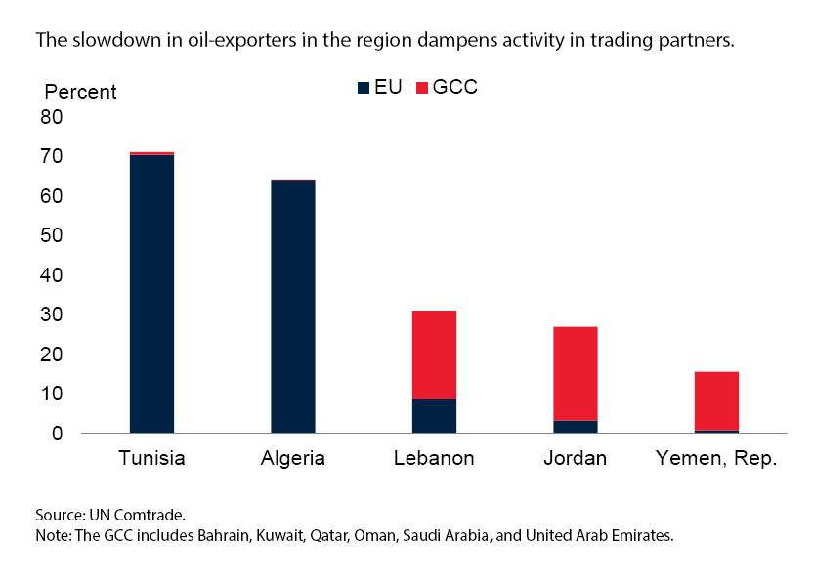
Share of exports to GCC and Euro Area Countries 2013

Slide 31
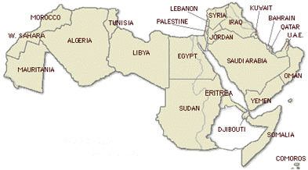
Post Arab Spring situation in the region
The region is being hit by a series of protests against local governments to remove the different rulers from office.
In Tunisia have been successful in removing Zine el Abidine Ben Ali from office on the 14th of January 2011.
Moncef Marzouki, a veteran human rights activist, was elected as president of Tunisia that December.
The National Constitutional Assembly voted a constitution for the country. But strong presence of Jihadist as proven by recent attack in an Spanish Riu hottel
In Egypt, Hosni Mubarak was the first president of this country to give up power on the 11th of February, 2011 after ruling it for almost 30 years and Egypt’s ruling generals took control of the state from Mubarak. In June 2012, the Islamist from the Muslim brothers, Mohamed Mursi, won Egypt’s first presidential elections after Mubarak. Islamist parties control 73.7 per cent of the seats in the Egyptian parliament. The economic situation has deteriorated, the currency was devaluated and the divisions in the country between secular and islamist forces remain very acute.
On the 3rd of July 2013, President Morsi was brought down by the army, encouraged by the majority of the population. Now elections took place in order to vote for a constitution and a new President and Parlament for the country. General Morsi was elected President.
In Libya the Civil War ended with the capture of Gaddafi, who was captured and killed by their opponents after his convoy was attacked by NATO warplanes in 20 October 2011.
National Transitional Council was the de facto parliament of Libya.
Libya hold national elections in June 12 for a new national assembly. It elected former opposition leader Mohammed el-Megarif as the country's interim president on 10-8-2012
The country in now divided between 2 factions
In Syria the current situation is critical, when Assad refused to leave the power islamists started a civil war. ISIS has strongly appreared in the play.
In Yemen in February 2012, Saleh had resigned from the presidency and transferred power to his successor, marking the end of his 33-year rule.
Abdu Rabu Mansour Hadi was elected with 99% of the votes. He was the only candidate in the elections and served before as Saleh's vice president. Now he has been overruled and S Arabia has intevened in the country
Iran: landmark agreement on nuclear use reached on July -14-2015
Protests have upraised with different intensity in the rest of the countries such as Morocco, Bahrain, UAE, Mauritania, Saudi Arabia, Lebanon and Oman.
The elections in North Africa showing the growing support for Islamist parties raise a critical question: How committed are these parties to pluralist politics? Is Islamic Democracy (like post IIWW DC) possible?

Slide 32
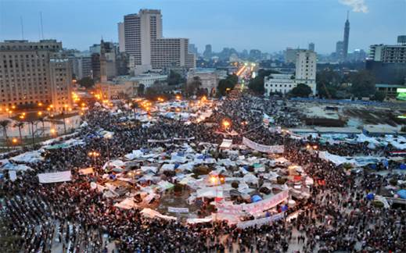
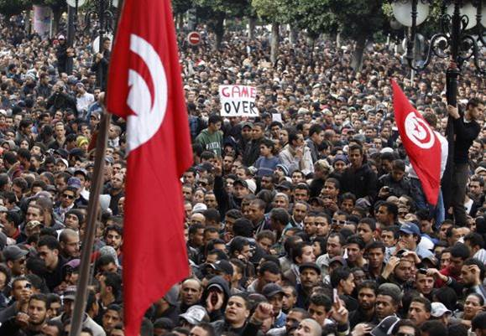
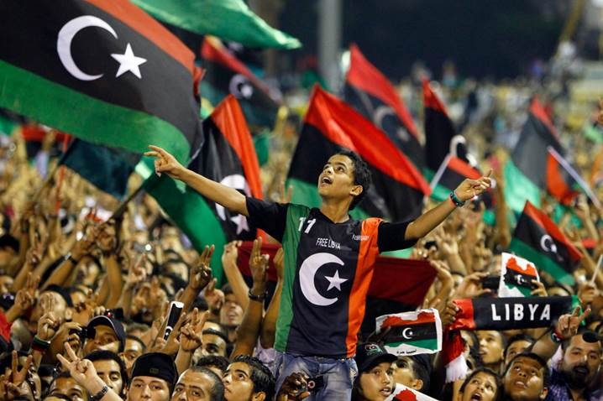
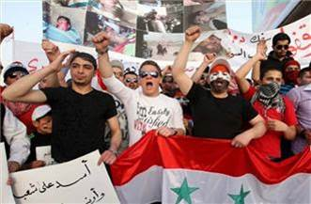
Egypt
Tunisia
Libya
Syria

Slide 33
Main causes for the uprisings in the region
?
BAD GOVERNANCE & CORRUPTION.
YOUNG UNEMPLOYMENT (the uprising is often called the Youth Revolution).
LACK OF FREEDOM OF OPINION (palliated by the internet and the social networks).
FOOD PRICES (mainly bread).
POVERTY.
Others: External intervention?

Slide 34
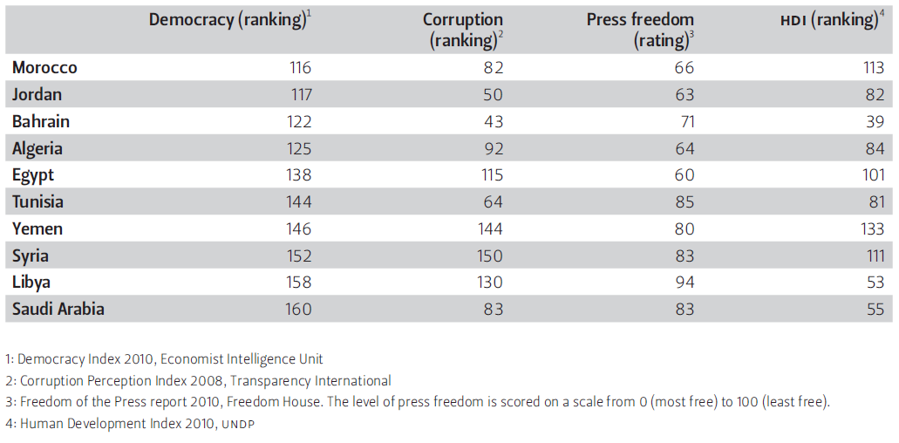
Main causes for the uprisings in the region (II)
BAD GOVERNANCE & CORRUPTION
The dictators from each country were accused of corruption by the local people and also from bad governance.
Corruption has led to the imprisonment of political figures and young activists without trials, illegal undocumented hidden detention facilities, and rejecting candidates to jobs in universities, mosques, newspapers, etc. based on political inclination.
YOUNG UNEMPLOYMENT
In the MENA region, 25% of youth between the ages of 15-29 are unemployed, which is one of the highest percentages in the world.
Some causes of this problem are growing youth population, lack of economic development, lack of appropriate skills and insufficient measures from the public sector.

Slide 35
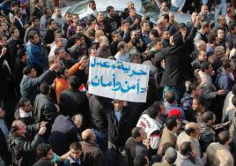
Main causes for the uprisings in the region (III)
LACK OF FREEDOM OF OPINION
Censorship was very common during most of the dictator's mandates. The internet has grown to such extent, that it is now a very powerful source of communications that allows any user to contact other people all around the world.
The internet and social networks were used by anti-government activists to plan the protests and to gather support. In response, the government blocked internet sites such as Facebook and Twitter to prevent any communications within them.
FOOD PRICES & POVERTY
Bread and cereal prices rose 2.42% in Algeria between November 2009 to 2010.
In Tunisia, whose popular uprising which toppled the country’s leader, Zine El Abidine Ben Ali, bread and cereal prices rose 3.5% during 2010.
Shortages of bread have hit Egypt very badly, as people had to make long queues to get some of it. Bread is the staple of the Egyptian diet.
Due to an increase in food prices, for example in bread, the purchasing power of individuals fell. Plus, the salary of the people did not increase in the same proportions so people had to deal with higher prices with the same money they earned monthly.

Slide 36
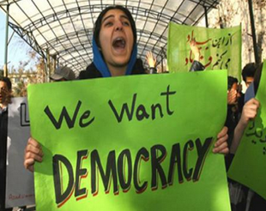
Conclusions
Although the situation in each country is very different, there is something in common to all of them:
- They have never known democracy and have the worst corruption index in the world
- They are tired of submission and dictatorships and are revealing against it
There was a generalized enthusiasm to seek for freedom and good living conditions. Now there is disenchantment in most countries and a tragic feeling of catastrophe and misfortune In those suffering civil war
Now most people is skeptic about the Arab Spring and its aftermath and think that
Terrorism has increased in the region
Before all the energies were focused inside their own countries, it was thought, but not in the neighbor regions. Now we have discovered with the appearance of ISIL /ISIS and its political violent aims is clear that is spreading every where they can in the whole world.
Emigration can be uncontrollable. ISIS project to send hundreds of thousands by force
This would not happen if a country develops and is able to offer opportunities to its citizens
The renewed countries will make competition on goods and services tougher
This will affect more countries like China and other exporting economies. And nevertheless we should welcome free competition and prosperity
The Palestinian conflict will worsen
The arrival to power of more critical groups towards Israel might help the Palestinian cause or at least redistribute the forces in the region
TO DO: It is important that these countries play the main role in this process. The western powers and the EU should offer but not impose their expertise and knowledge. Paternalism would not help.
The objective has to be the consolidation of
-human rights and dignity
-political pluralism
-good governance
- population participation in the political life, including all the minorities and ethnicities.

Slide 37
Prof. José Félix Merladet

