Slide 1
Polarization, Politicization, Participation Projecting the EU beyond the market?
Francesco Nicoli
PhD Researcher
Università di Trento

Slide 2
Research questions
Polarization: does Eurosceptic Populism drive a different polarization of political systems?
Politicization/1: does Eurosceptic Populism increase the salience of EU issues during the elections?
Politicization/2: does Eurosceptic populism push coalition governments to perform better on EU policies?
Politicization/ 3 does Eurosceptic populism “spill over” national borders?
Participation: what is the correlation between Eurosceptic Populism and turnout?

Slide 3
Theoretical bases
Neofunctionalist theory of integration
The Eurocrisis is pushing the EU towards fiscal and possibly political integration
Lipset-Rokkan Cleavage model
The political system of the Euro Area is experiencing a reorganization on a new “centre-periphery” cleavage
Majone’s legitimacy theory
Democratic stance is determined by competences
Weiler’s legitimacy theory
“no demos assumption”: Europeans are not and shall not become a people so a fully democratic EU is impossible

Slide 4
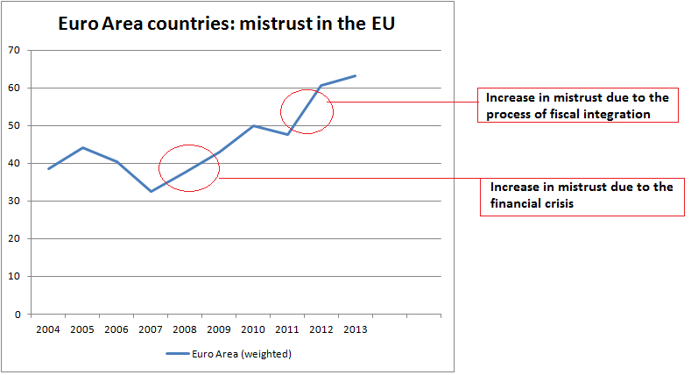
The effect of the crisis

Slide 5
Polarization/ national level
Does Eurosceptic populism drive a different polarization of political systems?
Since the outbreak of the crisis in the Euro Area, no parliamentary system where Eurosceptic parties reached 10% of the consensus has avoided large coalition governments
In the German case, the emergence of a weak eurosceptic party (AfD) still influenced the formation of the grand coalition government

Slide 6
Polarization/ EU level
At EU level, it is harder to define polarization as no governmental majorities exist, and majorities are often issue-dependent. National interests still play a role in the EP.
However, strong Eurosceptic forces in the EP, altogether with the possible effects of the new art. 17.7 TEU, may change the picture.
Deeper cleavage between “Pro-European” majority and “Eurosceptic” minority?

Slide 7
Politicization/1
Does Eurosceptic Populism increase the salience of EU issues during the elections?
Two electoral case studies: Italy (2013) and the Netherlands (2012)
In both cases, there is substantial evidence in support of the hypothesis. The EU policy and the Euro Area Membership have become essential parts of electoral programs of parties.
In both cases a coalition government emerged as a result, aiming to maintain the country on a pro-EU pace

Slide 8
Politicization/2
Does Eurosceptic populism push coalition governments to perform better on EU policies?
Analysis of the performances since 2009 in the European Union Single Market Scoreboard, that tracks the implementation of directives in nation states, suggest that pro-EU grand coalition governments deliver, in general, slightly better results than their political counterparts.
Between 2012 and 2013, four Grand Coalition governments (IT, IE, NL and EL) obtained their best result ever; two (AT, FI) increased their scores over the previous year; only one (BE) decreased its score.
In addition, Italy in particular delivered under Monti’s government an astonishing performance in reducing the number of outstanding directives (-21). The Netherlands also decreased it (-4)

Slide 9
Politicization/3
Does Eurosceptic populism “spill over” national borders?
Media interest in Euroscepticism abroad has increased alongside coverage of news related with the economic crisis (Meijers 2013)
The crisis has provided a common ground between many countries, creating a common “weak public sphere” and contributing to spread dissensus towards EU integration (De Wilde et. Al. 2014)
This dissensus is then “captured” at domestic level either by new political entrepreneurs (as AfD) or by pre-existing protest parties (as PVV, or M5S).
However, no conclusive evidence on the size of this phenomenon exists.

Slide 10
Participation
What is the correlation between Eurosceptic Populism and turnout?
- Analysis of electoral data from all EA elections since 2009
Very small countries experience different electoral dynamics than large countries
Apparently, Euroscepticism and turnout are negatively correlated. The correlation is rather weak (R² = 0,17). However, the correlation is heavily influenced by the Spanish and Finnish observation. Excluding them from the sample raises R² to 0,72.
So, at a first glance, Euroscepticism is higher when turnout is low.

Slide 11
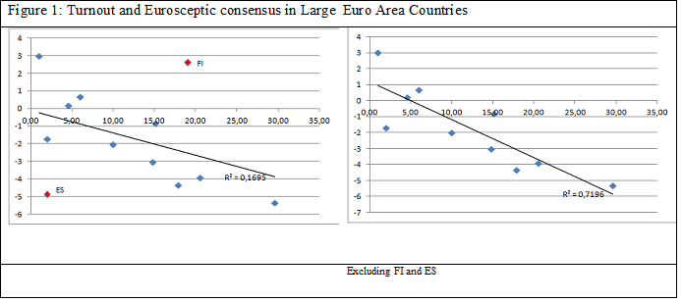
Participation/2

Slide 12
Participation/3
However, it is unlikely that turnout and Euroscepticism are causally correlated. Instead, they appear to be both influenced by the same factors.
Both Euroscepticism and turnout are correlated with economic performance and mistrust in the party system:
When economic performance in the semester before the elections is bad, we observe both a rise in Eurosceptic vote and a fall in turnout
Similarly, when mistrust in the party system rises, turnout falls and Euroscepticism rises.

Slide 13
Participation/4
Finally, data seem to suggest instead that Euroscepticism may have a “buffer” function.
If we group countries accordingly to the evolution of mistrust in the party system between 2009 and the semester of the election, we observe that – for similar levels of change in mistrust- higher Euroscepticism may imply slightly higher turnout
This effect seems stronger when the group has low changes in mistrust, and tends to disappear in groups with larger changes
While there is no conclusive evidence, these findings suggest that populist forces may gather protest vote keeping deluded voters into the political system.
This is consistent with the rational-choice model developed by Hobolt and Spoon (2012)

Slide 14
Conclusions
Euroscepticism seems the inevitable consequence of the expansion of EU integration in the political sphere
Euroscepticism is provoking a reorganization of party coalitions all across the Euro Area.
Euroscepticism may contribute in creating a European public sphere, although negatively characterized
Euroscepticism generates higher salience of European issues domestically and abroad
Euroscepticism is more likely to appear when the confidence in the party system is low, and may represent a buffer against even lower turnout levels.

Slide 15
For comments, requests, questions and suggestions please write at francesco.nicoli@unitn.it
Thank you for your attention!

